Slide 1




Course : Machine Learning
Lecture On : Understanding CNN
Instructor : Siddhesh Gunjal
EEdiditt MMaaststeerr tteexxtt ststyleyless
16-05-2021
2

Slide 2



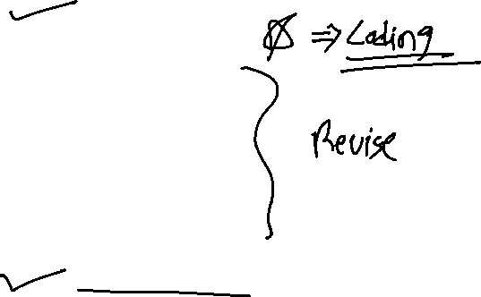
Today’s Agenda
Recap of CNN
Feature Extraction
Stride
Filters
Padding
Dropout
Pooling Layer
Code Walkthrough
16-05-2021
PG Diploma in ML/AI
3

Slide 3
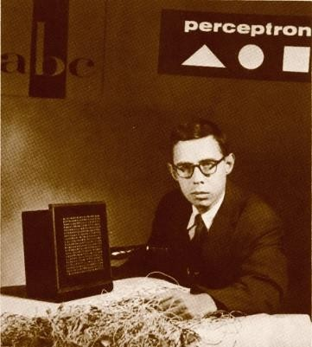
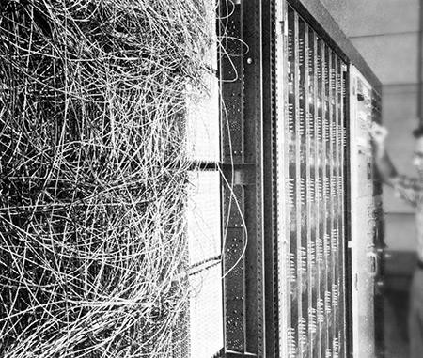
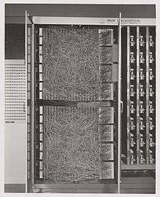
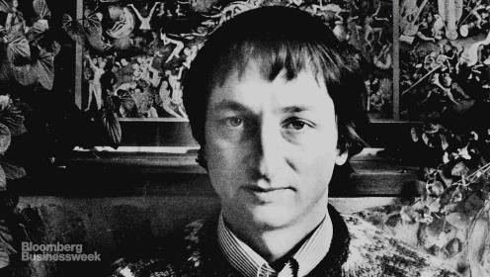
we have come a long way with DL
Rosenblatt, with the image sensor of the Mark I Perceptron
The perceptron algorithm was invented in 1958 at the Cornell Aeronautical Laboratory by Frank Rosenblatt, funded by the United States Office of Naval Research
Deep learning is an algorithm which has no theoretical limitations of what it can learn ;the more data you give and the more computational time you provide the better it is - Geoffrey Hilton(Google)
3

Slide 4
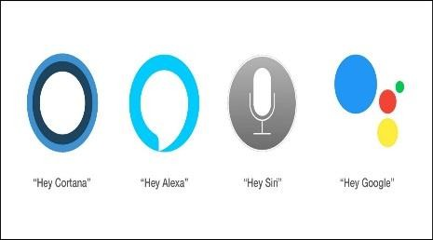





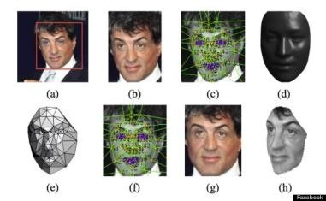



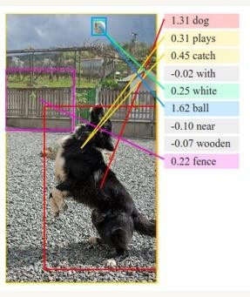
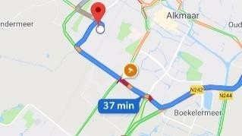



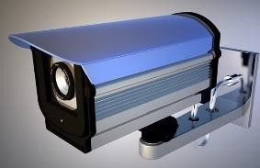
Neural Networks in Business
Voice Assistants
Recommendation Engines
The Terminator
Google
Search
Translate
maps
Facial Recognition
Self-driving cars
Image
Understanding
Email filtering
Customer Support Queries (and Chatbots)
https://www.analyticsvidhya.com/blog/2018/05/24-ultimate-data-science-projects-to-boost- your-knowledge-and-skills/
Catching Fraud in Banking
Video Surveillance
4

Slide 5
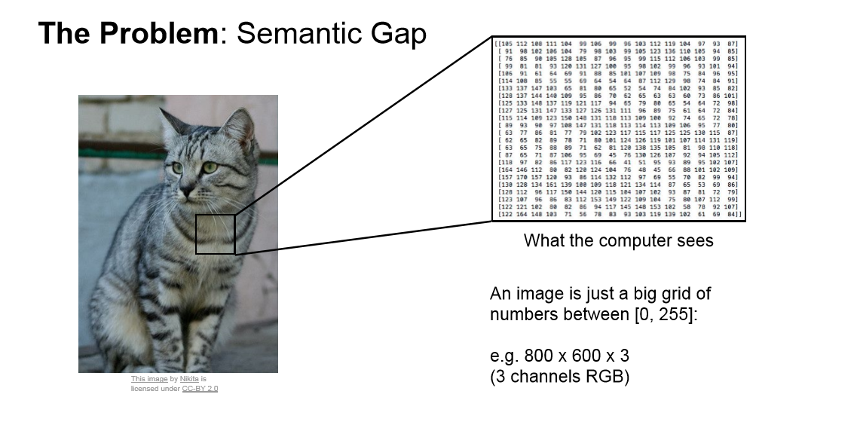
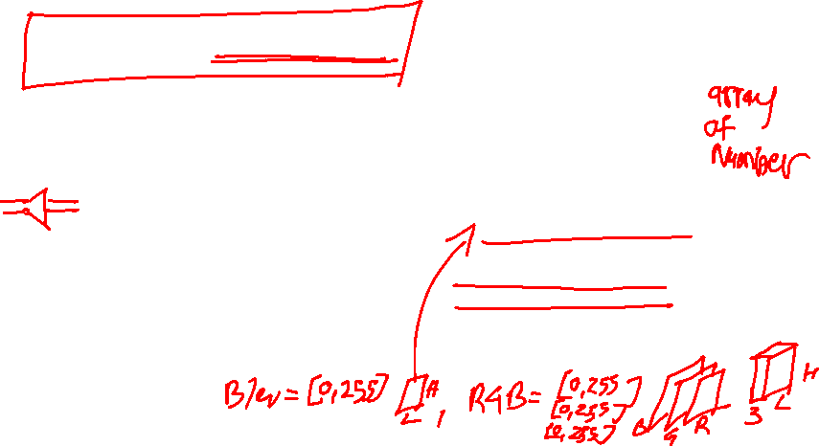
An Image is a matrix of pixel values
6

Slide 6

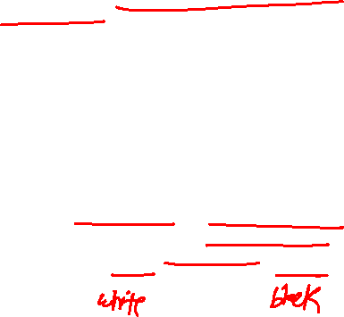
An Image is a matrix of pixel values
Every Image is nothing but a matrix of different Pixel Values
Channel is a conventional term used to refer to a certain component of an image. An image from a standard digital camera will have three channels – red, green and blue – you can imagine those as three 3d-matrices stacked over each other (one for each color), each having pixel values in the range 0 to 255
Grey Scale Image will have a single 2d matrix representing an image. The value of each pixel in the matrix will range from 0 to 255 –
zero indicating black and 255 indicating white
Every image is a matrix of pixel values. Source [6]
6

Slide 7
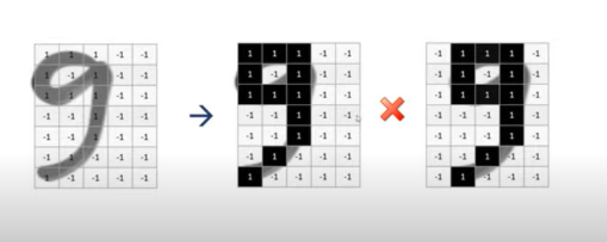
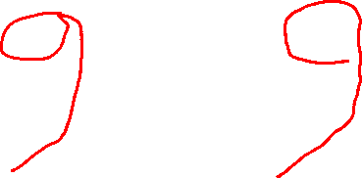

Slide 8
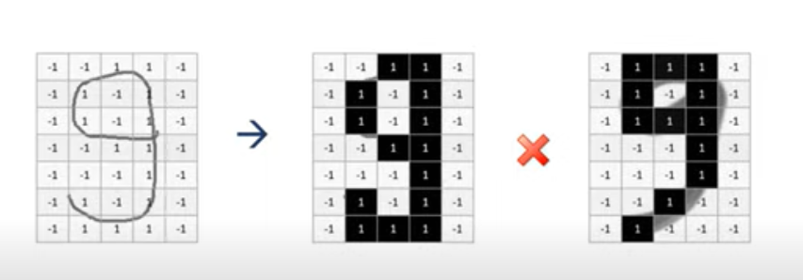


Slide 9
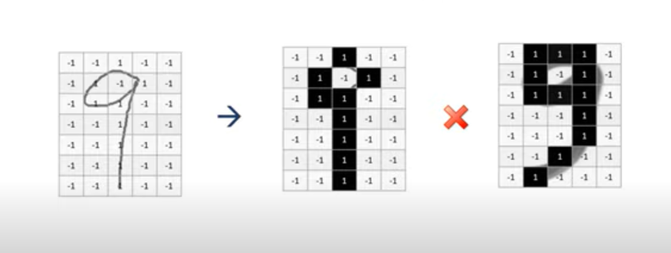

Slide 10
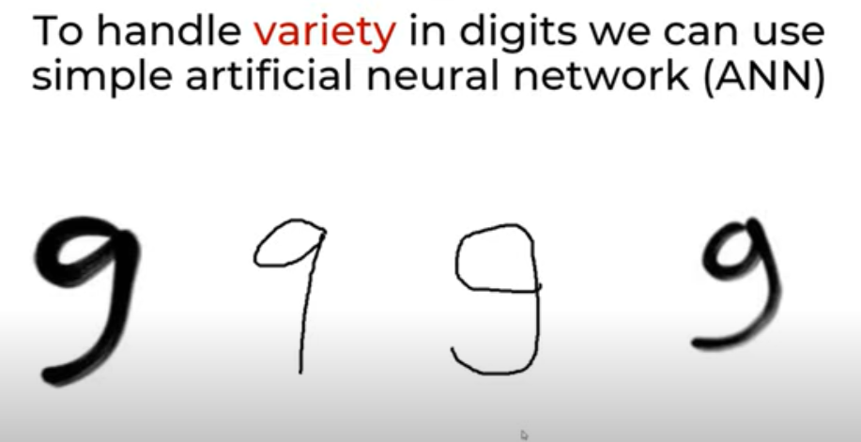
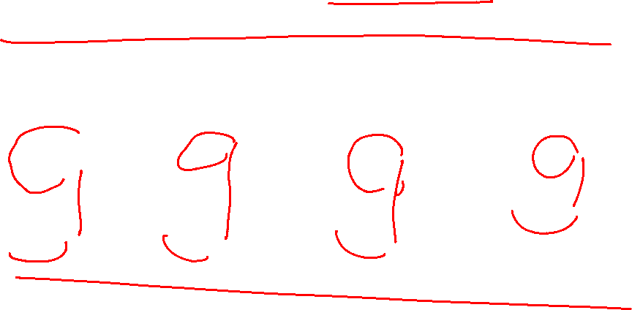

Slide 11

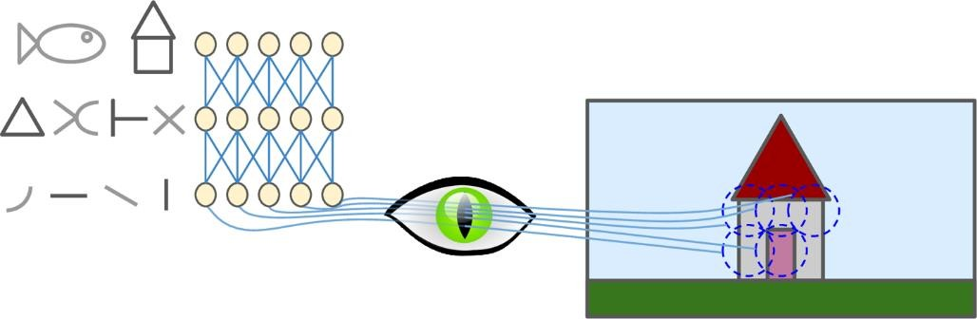
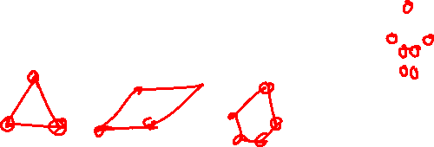
What are CNNs and why do we need them?
The need for using CNNs arose from a better representation learning for image analysis.
Representation Learning is a technique that allows a system to automatically find
relevant features for a given task and replaces manual feature engineering.
Biological neurons in the visual cortex respond to specific patterns in small regions of the visual field called receptive fields; as the visual signal makes its way through consecutive brain modules, neurons respond to more complex patterns in larger receptive fields.
7

Slide 12
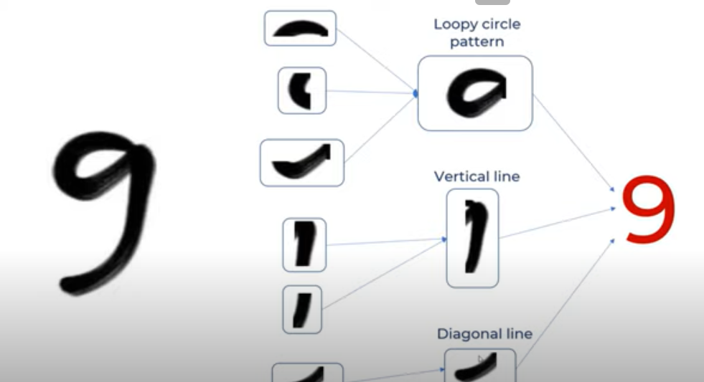
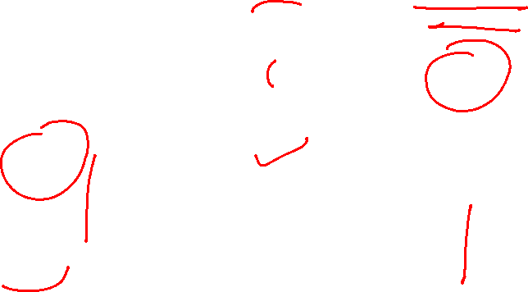

Slide 13
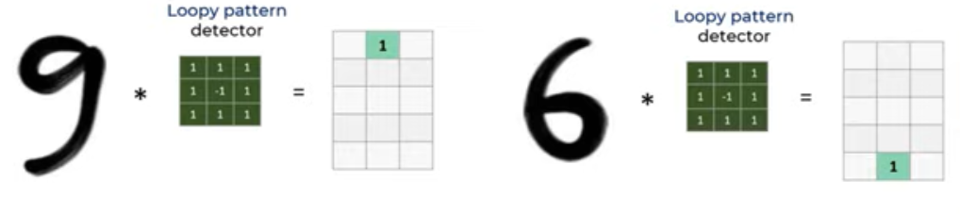
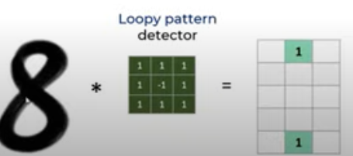
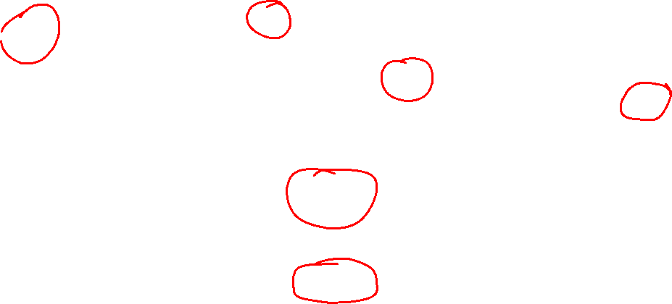

Slide 14
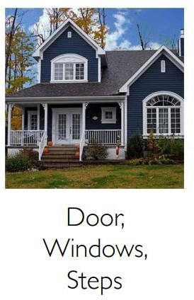

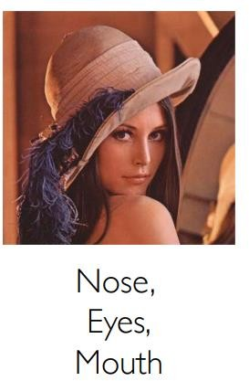
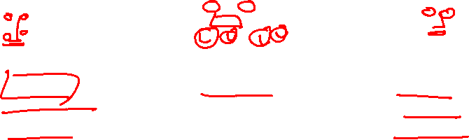
Image Features

Slide 15
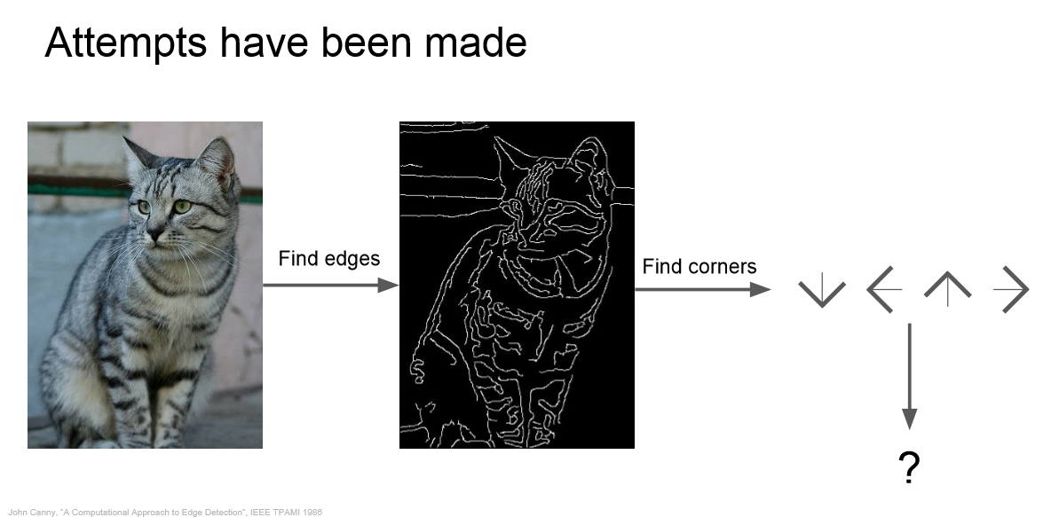
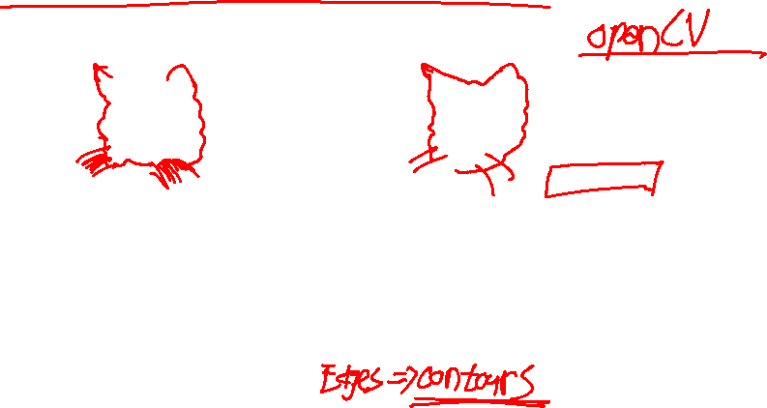

Slide 16
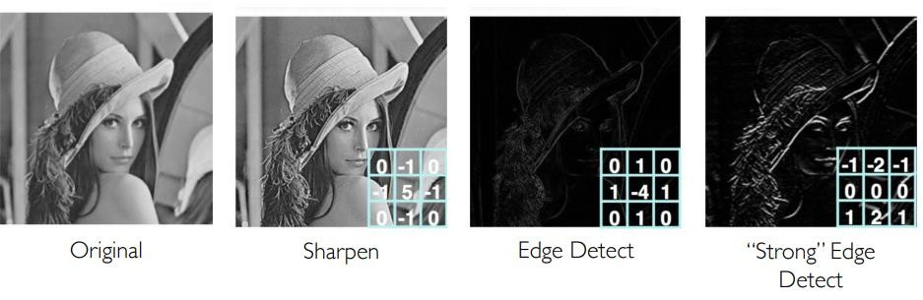
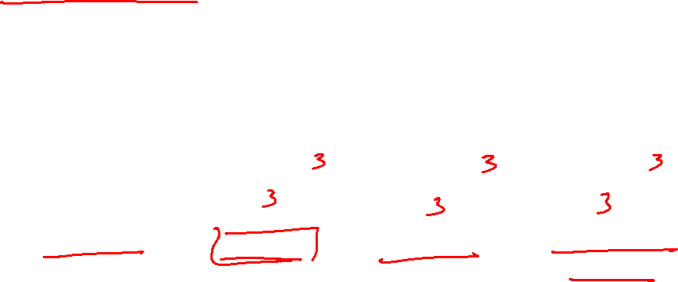
Feature maps

Slide 17
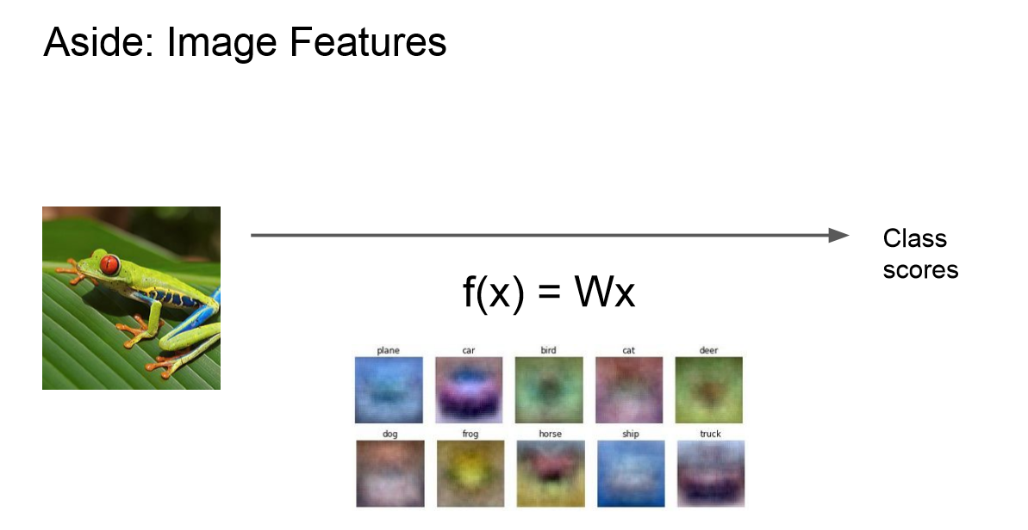
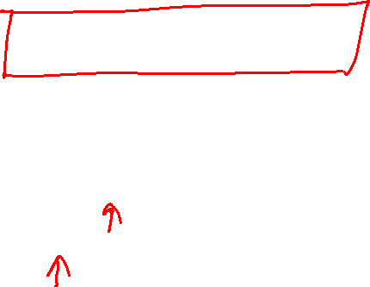

Slide 18
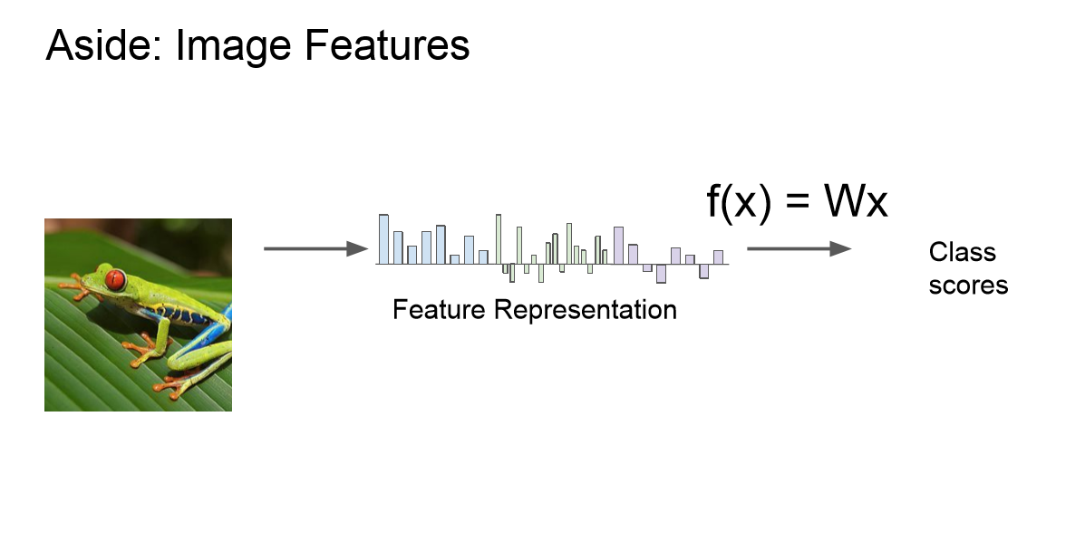

Slide 19
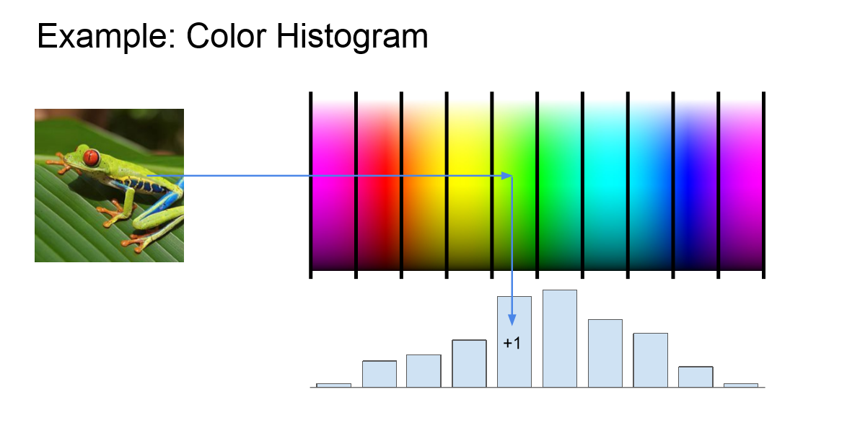
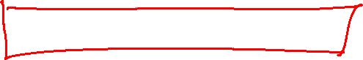

Slide 20
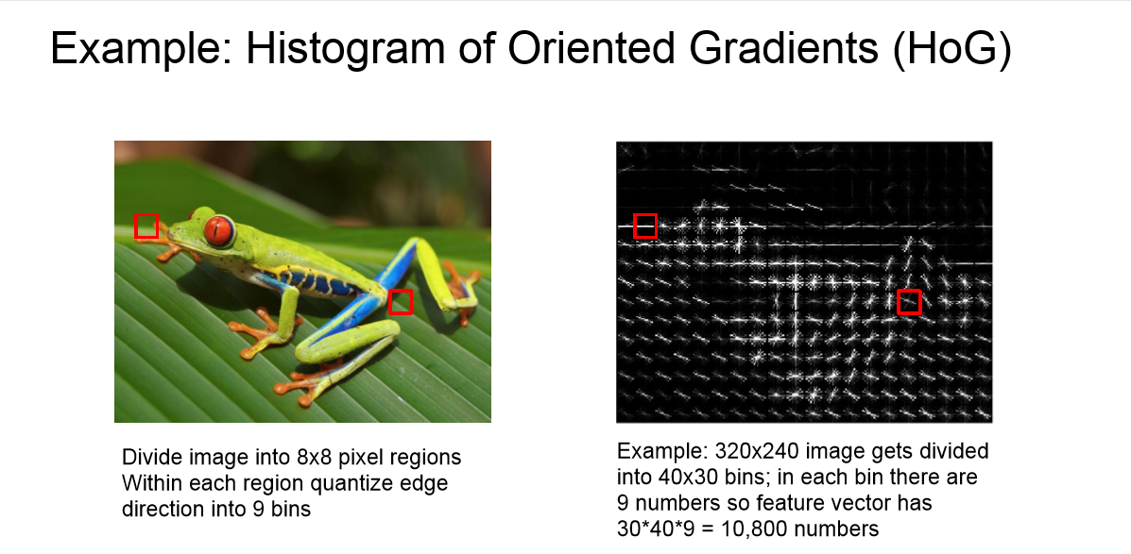
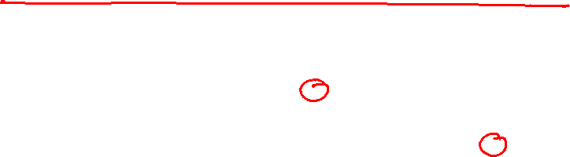

Slide 21
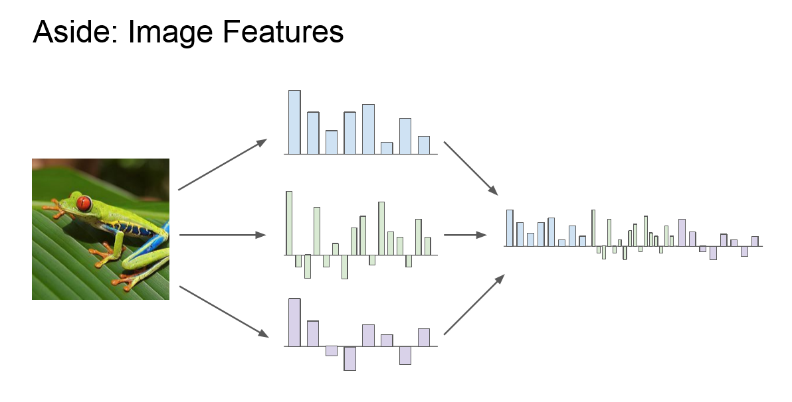

Slide 22
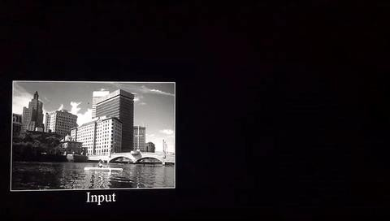

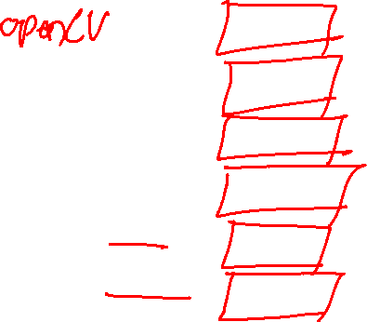
Different Filter Matrix ->> Diff Feature Maps ->>same Image
https://cs.nyu.edu/~fergus/tutorials/deep_learning_cvpr12/
9

Slide 23
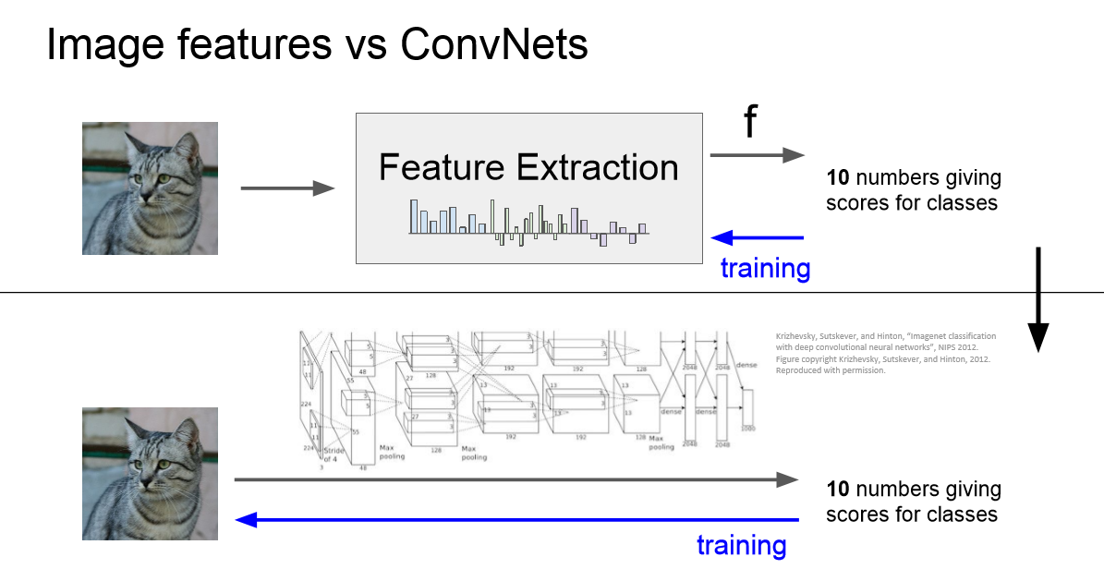
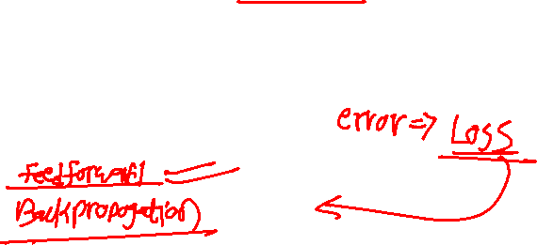

Slide 24
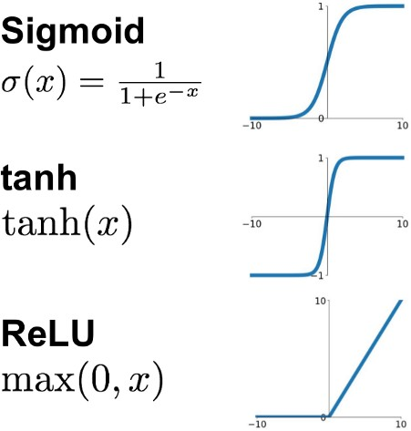
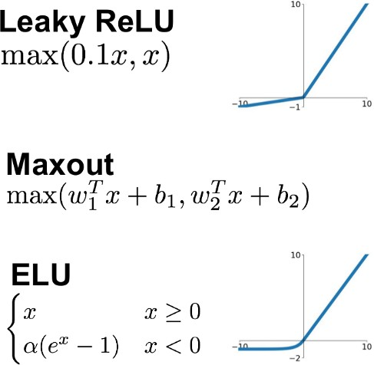
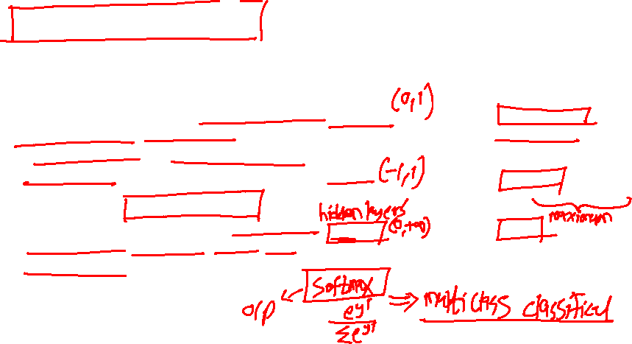
Activation functions
Activation functions are really important for a Artificial Neural Network to learn and make sense Non-linear complex functional mappings between the inputs and response variable.
They introduce non-linear properties to our Network. Their main purpose is to convert a input signal of a node in a A-NN to an output signal. That output signal now is used as a input in the next layer in the stack.
https://ai.stackexchange.com/questions/5493/what-is-the-purpose-of-an-activation-function-in-neural-networks

Slide 25
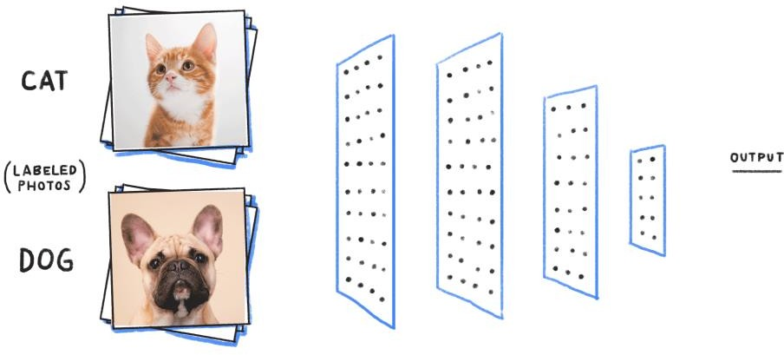
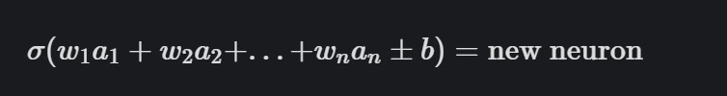



Feedforward
the output from one layer is used as input to the next layer. Such networks are called feedforward neural networks.

Slide 26


Example
To create a classifier we want the output to look like as set of probabilities
By feeding the input through the network we get a set of scores Y called “logits” but in here they cannot be used as probabilities
They are not within the range [0,1]
They do not add up to 1.

Slide 27



Example
To convert logits into probabilities we can use the softmax function
This guarantees all values are between [0,z] and they add up to 1.

Slide 28


Cost Function
A Cost Function/Loss Function evaluates the performance of our Machine Learning Algorithm. The Loss function computes the error for a single training example while the Cost function is the average of the loss functions for all the training examples.
The goal of any Learning Algorithm is to minimize the Cost Function.
lower error between the actual and the predicted values signifies that the algorithm has done a good job in learning.
A common measure of the discrepancy between the two values is the ”Cross-entropy”

Slide 29


Convolution for Feature Extraction
Filter of size 5x5 : 16 different weights
Apply this same filter to 5x5 patches in input
Shift by 1 pixels for next patch
Apply a set of weights – a filter – to extract local features
Use multiple filters to extract different features
Spatially share parameters of each filter

Slide 30

Strides
Stride is the number of pixels shifts over the input matrix. When the stride is 1 then we move the filters to 1 pixel at a time. When the stride is 2 then we move the filters to 2 pixels at a time and so on.
Stride helps to reduce the size of the image, a particularly useful feature.
This dramatically reduces the model’s computational complexity. The shift from one receptive field to the next is called the stride

Slide 31
Strides
Suppose we choose a stride of 2. So, while convoluting through the image, we
will take two steps – both in the horizontal and vertical directions separately.
Stride helps to reduce the size of the image, a particularly useful
feature
The dimensions for stride s will be:
Input: n X n Padding: p Stride: s
Filter size: f X f
Output: [(n+2p-f)/s+1] X [(n+2p-f)/s+1]

Slide 32
Convolution for Feature Extraction
32x32x3 image
32
height
32
width
3
depth
Slide credit: CS231n Lecture 7

Slide 33
Convolution for Feature Extraction
32x32x3 image
Filters always extend the full depth of the input volume
32
height
5x5x3 filter
Convolve the filter with the image
i.e. “slide over the image spatially, computing dot products”
32
width
3
depth
Slide credit: CS231n Lecture 7

Slide 34

Convolution for Feature Extraction
activation maps
32x32x3 image
5x5x3 filter
32
28
convolve (slide) over all spatial locations
32
28
3
1

Slide 35




What is Convolution ?
Consider a 5 x 5 image whose pixel values are only 0 and 1)
consider another 3 x 3 matrix as shown [ Filters or Kernel or
Feature Detector]
Final Output – Convolved Feature or Activation Map or Feature
Map
Source - Convolved Feature or Feature Map. Source8 [7]

Slide 36


Slide 37
Convolution for Feature Extraction
Filter of size 5x5 : 16 different weights
Apply this same filter to 5x5 patches in input
Shift by 1 pixels for next patch
Apply a set of weights – a filter – to extract local features
Use multiple filters to extract different features
Spatially share parameters of each filter

Slide 38
Convolution for Feature Extraction
activation maps
32x32x3 image
5x5x3 filter
32
28
convolve (slide) over all spatial locations
32
28
3
consider a second, green filter
2

Slide 39

For example, if we had 6 5x5 filters, we’ll get 6 separate activation maps:
activation maps
32
28
Convolution Layer
32
28
3
6
We stack these up to get a new “image” of size 28x28x6!

Slide 40

ConvNet is a sequence of Convolution Layers, interspersed with activation functions
32
28
24
….
CONV,
ReLU
e.g. 6 5x5x3 filters
CONV,
ReLU
e.g. 10 5x5x6 filters
CONV,
ReLU
32
28
24
3
6
10

Slide 41
Convolution - Drawbacks
We can generalize it and say that if the input is n X n and the filter size is f X f, then the output size will be (n-
f+1) X (n-f+1):
Input: n X n
Filter size: f X f
Output: (n-f+1) X (n-f+1)
There are primarily two disadvantages here:
Every time we apply a convolutional operation, the size of the image shrinks
Pixels present in the corner of the image are used only a few number of times during convolution as compared to the central pixels. Hence, we do not focus too much on the corners since that can lead to information loss

Slide 42
A closer look at spatial dimensions:
7
7x7 input (spatially)
assume 3x3 filter
7

Slide 43
A closer look at spatial dimensions:
7
7x7 input (spatially)
assume 3x3 filter
7

Slide 44
A closer look at spatial dimensions:
7
7x7 input (spatially)
assume 3x3 filter
7

Slide 45
A closer look at spatial dimensions:
7
7x7 input (spatially)
assume 3x3 filter
7

Slide 46
A closer look at spatial dimensions:
7
=> 5x5 output
7x7 input (spatially)
assume 3x3 filter
7

Slide 47
A closer look at spatial dimensions:
7
7x7 input (spatially)
assume 3x3 filter
applied with stride 2
7

Slide 48
A closer look at spatial dimensions:
7
7x7 input (spatially)
assume 3x3 filter
applied with stride 2
7

Slide 49
A closer look at spatial dimensions:
7
7x7 input (spatially)
assume 3x3 filter
applied with stride 2
=> 3x3 output!
7

Slide 50
A closer look at spatial dimensions:
7
7x7 input (spatially)
assume 3x3 filter
applied with stride 3?
7

Slide 51
A closer look at spatial dimensions:
7
7x7 input (spatially)
assume 3x3 filter
applied with stride 3?
7
doesn’t fit!
cannot apply 3x3 filter on 7x7 input with stride 3.

Slide 52

N
Output size:
(N - F) / stride + 1
e.g. N = 7, F = 3:
stride 1 => (7 - 3)/1 + 1 = 5
stride 2 => (7 - 3)/2 + 1 = 3
stride 3 => (7 - 3)/3 + 1 = 2.33 :\
F
F
N

Slide 54


Padding
There are the two main downsides
Shrinking outputs
Loosing information on corners of the image
when it come to convolving as we discussed the image will shrink and if we take multiple CNN layers we will get a small image after getting filtered in the end.
The pixel in the corner will only get covers one time but if you take the middle pixel it will get covered more than once basically what does that means is we have more info on that middle pixel

Slide 55

In practice: Common to zero pad the border
0 | 0 | 0 | 0 | 0 | 0
0
0
0
0
e.g. input 7x7
3x3 filter, applied with stride 1
pad with 1 pixel border => what is the output?
(recall:)
(N - F) / stride + 1

Slide 56
In practice: Common to zero pad the border
0 | 0 | 0 | 0 | 0 | 0
0
0
0
0
e.g. input 7x7
3x3 filter, applied with stride 1
pad with 1 pixel border => what is the output?
7x7 output!

Slide 57

In practice: Common to zero pad the border
0 | 0 | 0 | 0 | 0 | 0
0
0
0
0
e.g. input 7x7
3x3 filter, applied with stride 1
pad with 1 pixel border => what is the output?
7x7 output!
in general, common to see CONV layers with stride 1, filters of size FxF, and zero-padding with (F-1)/2. (will preserve size spatially)
e.g. F = 3 => zero pad with 1
F = 5 => zero pad with 2
F = 7 => zero pad with 3

Slide 58

Padding Summary

Slide 59


Padding Summary
Common settings:
K = (powers of 2, e.g. 32, 64, 128, 512)
F = 3, S = 1, P = 1
F = 5, S = 1, P = 2
F = 5, S = 2, P = ? (whatever fits)
F = 1, S = 1, P = 0

Slide 60


Padding
Now there is more frame that covers the edge pixels of an image and we can see that the output has maintained the dimensions of the input, this runs due to filling with zeros.
Input: n X n Padding: p Filter size: f X f
Output: (n+2p-f+1) X (n+2p-f+1)

Slide 61


What is Dropout?

Slide 62

What is Dropout?

Slide 63


Pooling Layer
Makes the representation smaller and more manageable
Operates over each activation map independently

Slide 64

Max Pooling
Single depth slice
1 | 1 | 2 | 4
5 | 6 | 7 | 8
3 | 2 | 1 | 0
1 | 2 | 3 | 4
x
max pool with
2x2 filters and stride 2
6 | 8
3 | 4
y

Slide 65



Pooling Layer
Pooling layers are generally used to reduce the size of the inputs and hence speed up the computation.
Apart from max pooling, we can also apply average pooling where, instead of taking the max of the numbers, we take their average. The hyperparameters for a pooling layer are:
Filter size
Stride
Max or average pooling

Slide 66


Pooling Layer
Common settings:
F = 2, S = 2
F = 3, S = 2

Slide 67

But why DL ??
Manually designed features are often over-specified, incomplete and take a long time to design and validate
Learned Features are easy to adapt, fast to learn
Deep learning provides a very flexible, (almost?) universal, learnable framework for
representing world, visual and linguistic information.
Can learn both unsupervised and supervised
Effective end-to-end joint system learning
Utilize large amounts of training data

Slide 68

Evolution of CNN Architectures
It all started with LeNet in 1998 and eventually, after nearly 15 years, lead to ground breaking models winning the ImageNet Large Scale Visual Recognition Challenge which includes AlexNet in 2012 to GoogleNet in 2014 to ResNet in 2015 to ensemble of previous models in 2016. In the last 2 years, no significant progress has been made and the new models are an ensemble of previous ground breaking models.

Slide 69


Let’s see an example

Slide 71

Thank You !
https://tfhub.dev/ https://www.tensorflow.org/hub https://tfhub.dev/google/tf2-preview/mobilenet_v2/classification/4 https://www.tensorflow.org/api_docs/python/tf/keras/callbacks/ https://www.tensorflow.org/api_docs/python/tf/keras/callbacks/ModelCheckpoint
https://arxiv.org/pdf/2006.06882.pdf

